Slide 1
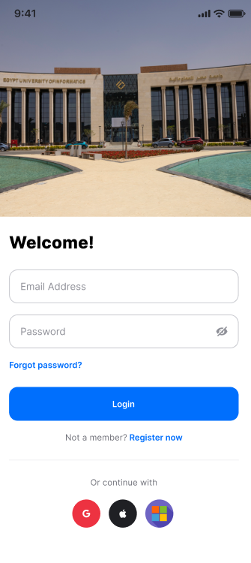
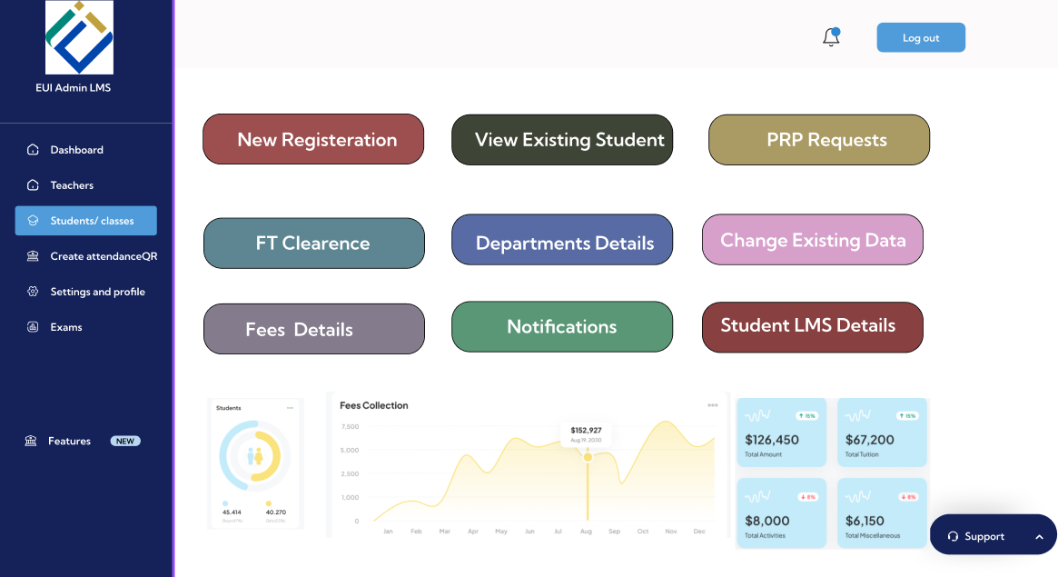
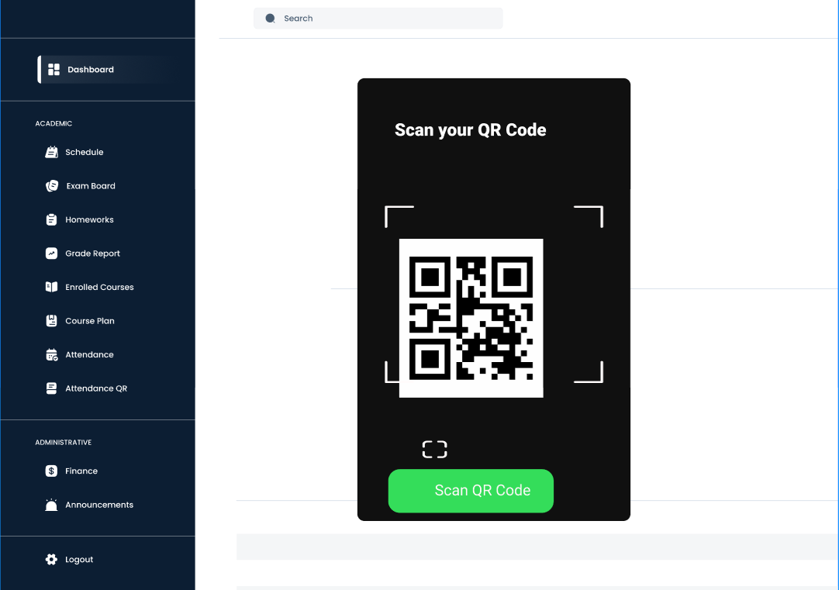
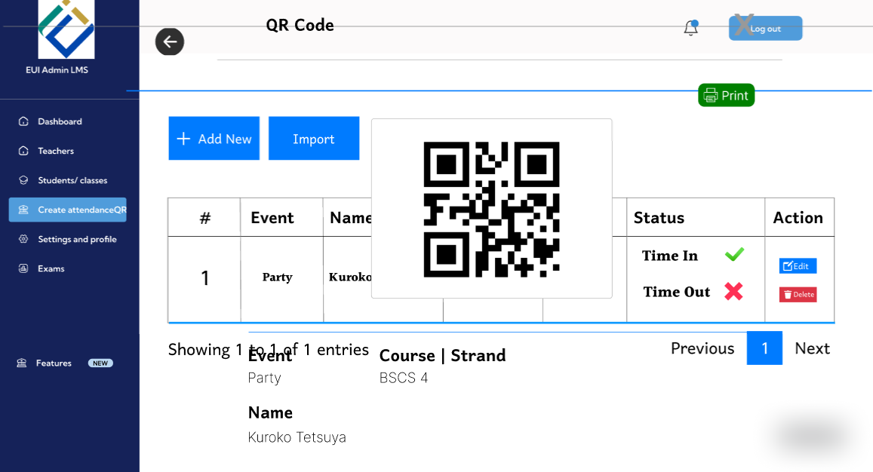
Login Via QR Code
2-
1-
4-
3-

Slide 2
Lecturer / Admin Side (QR Creation)
System: "Welcome to EduTrack. Please log in to continue."
Instructor: "Enter email and password."
System: "Login successful."
Instructor: "Click on Create QR Code."
System: "QR code is being generated..."
System: "QR code generated successfully. Please display it for students to scan."

Slide 3
Student Side (Attendance Recording)
System: "Welcome to EduTrack Attendance."
Student: "Enter my email."
System: "Email verified. Please proceed to attendance."
System: "Enter Attendance QR."
Student: "Scan QR code."
System: "QR received. Validating..."
If the QR code is valid
System: "Attendance recorded successfully."
System: "Thank you. You are marked present."
If the QR code is invalid
System: "Error: Invalid QR code."
System: "Please try again or contact your lecturer."

Slide 4
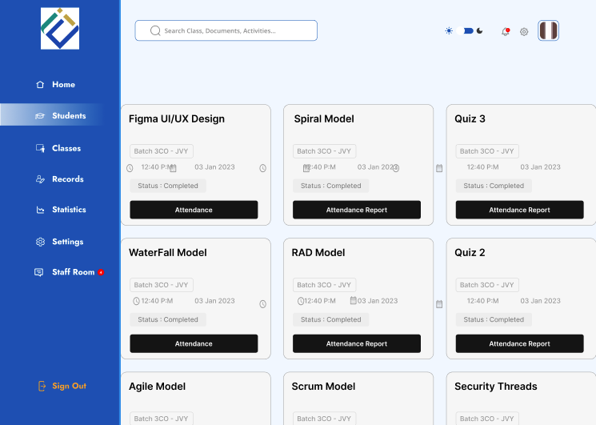
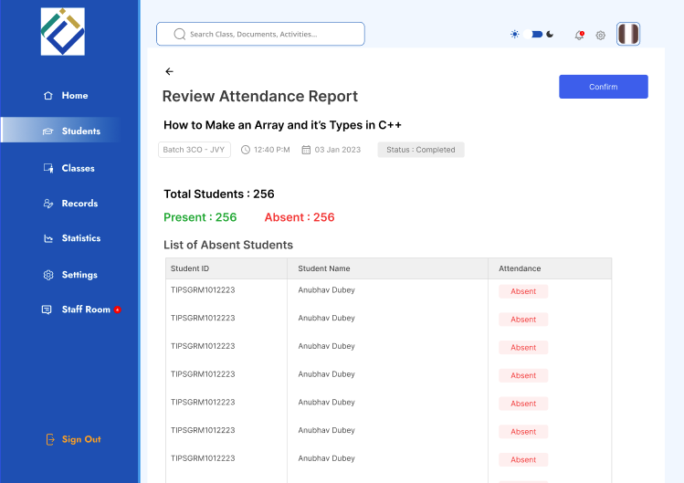
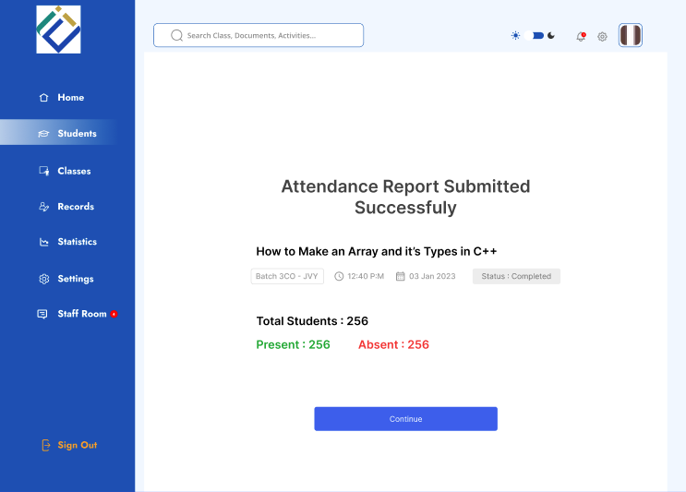
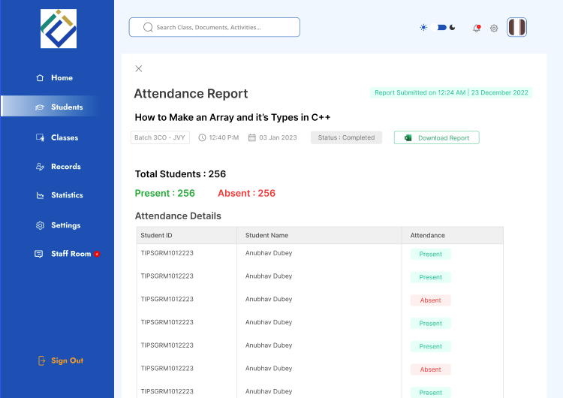
Generate attendance report& end of term report
1-
2-
3-
4-

Slide 5
Dialog for Generate attendance report& end of term report
  User: Logs into the system
  System: Displays available courses
  User: Selects a course
  System: Shows attendance summary and student list
  User: Reviews attendance data
  User: Confirms attendance report
  System: Displays submission success message
  User: Continues to final report
  System: Displays final attendance details
  User: Downloads attendance / end-of-term report
  System: Generates and downloads the report

Slide 6
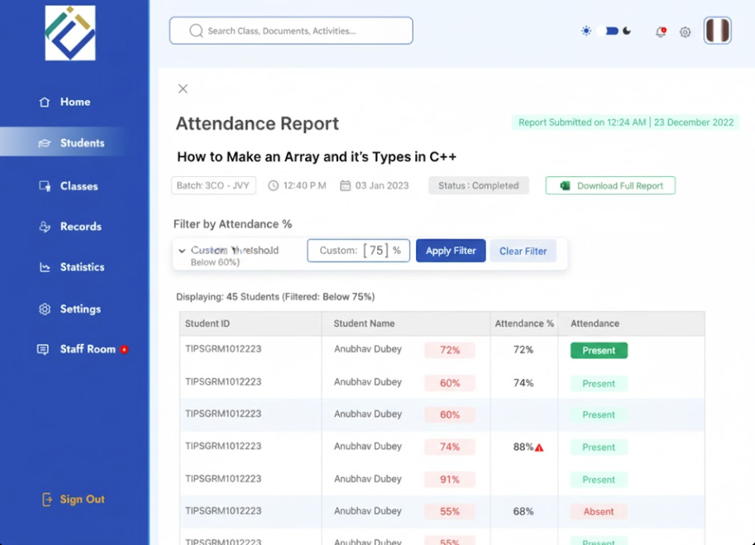
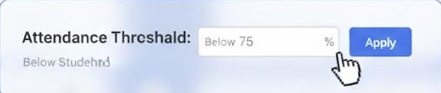

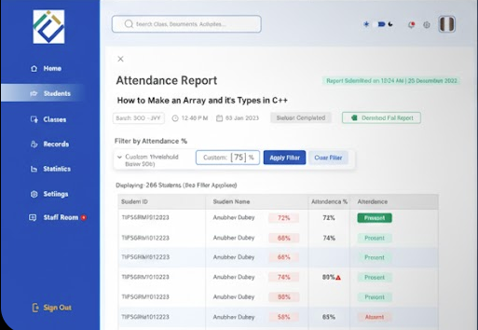
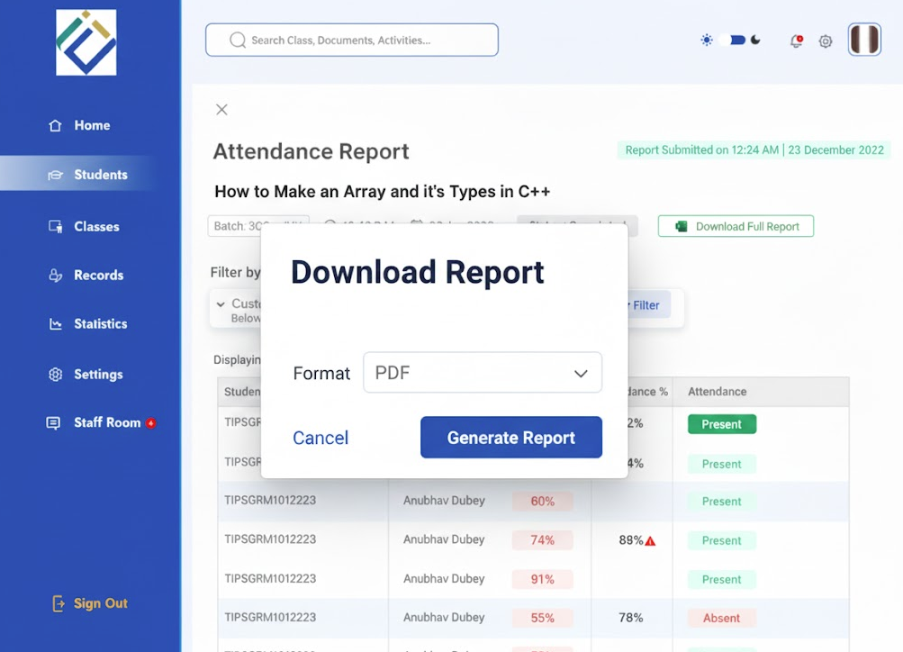
Generate at risk students
1-
2-
4-
3-

Slide 7
Generate at risk students
User: Opens attendance list
System: Displays attendance data
User: Sets attendance threshold (below 75% or 60%)
User: Clicks Apply
System: Filters and displays at-risk students
User: Reviews filtered list
User: Clicks Download Report
System: Shows report format options
User: Selects PDF and confirms
System: Generates and downloads the at-risk students report

Slide 8
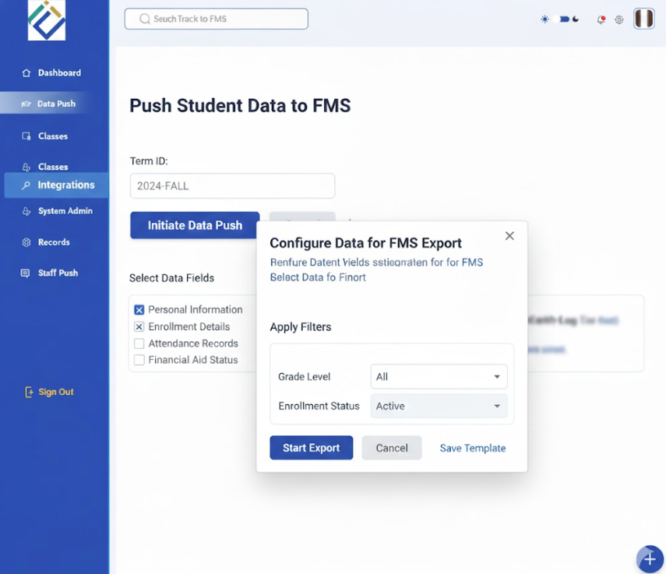
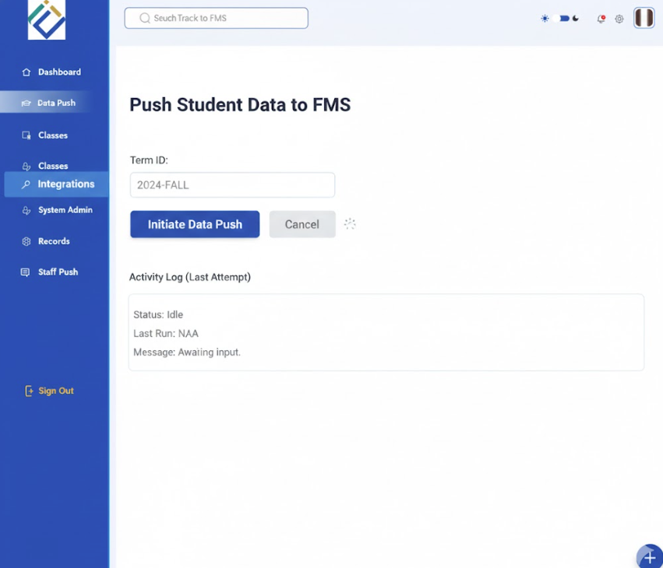
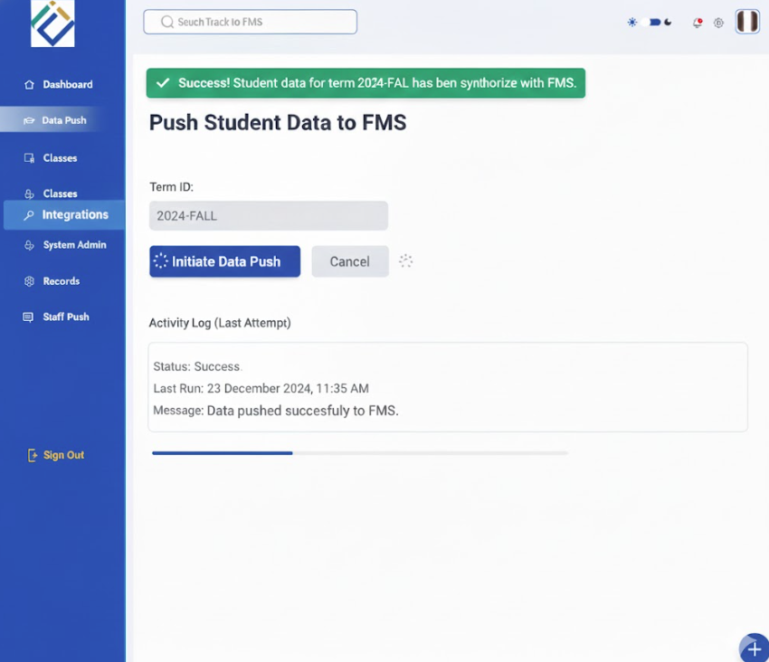
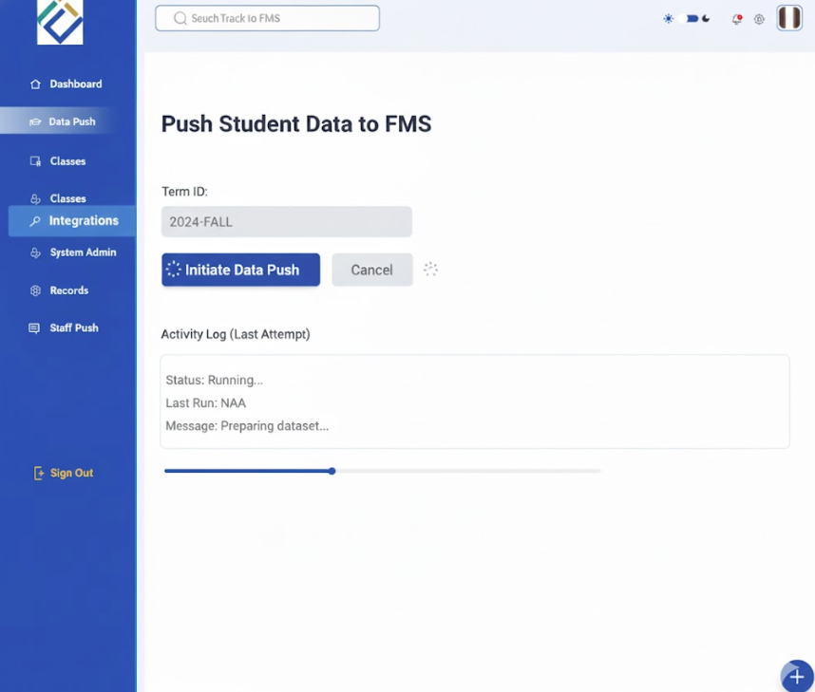
Push data to FMS
1-
2-
4-
3-

Slide 9
Push data to FMS
User: Opens Push Student Data to FMS
System: Displays term, course, and data options
User: Selects course and required data fields
User: Applies export filters
User: Clicks Initiate Data Push
System: Validates selected data
System: Prepares dataset
System: Pushes data to FMS
System: Displays success message

